Slide 1
IT Women
Vicki Rogers
vickir@uga.edu
vicki.rogers@oit.gatech.edu

Slide 2
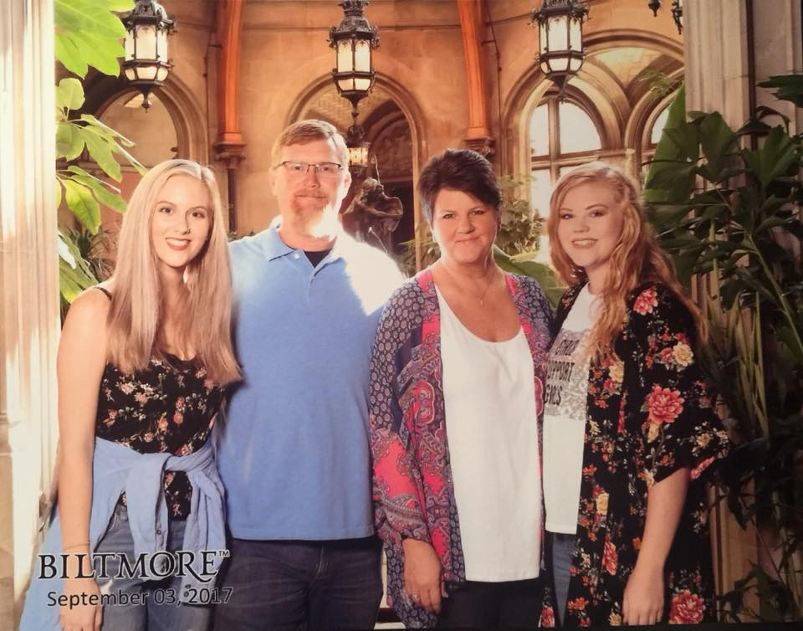
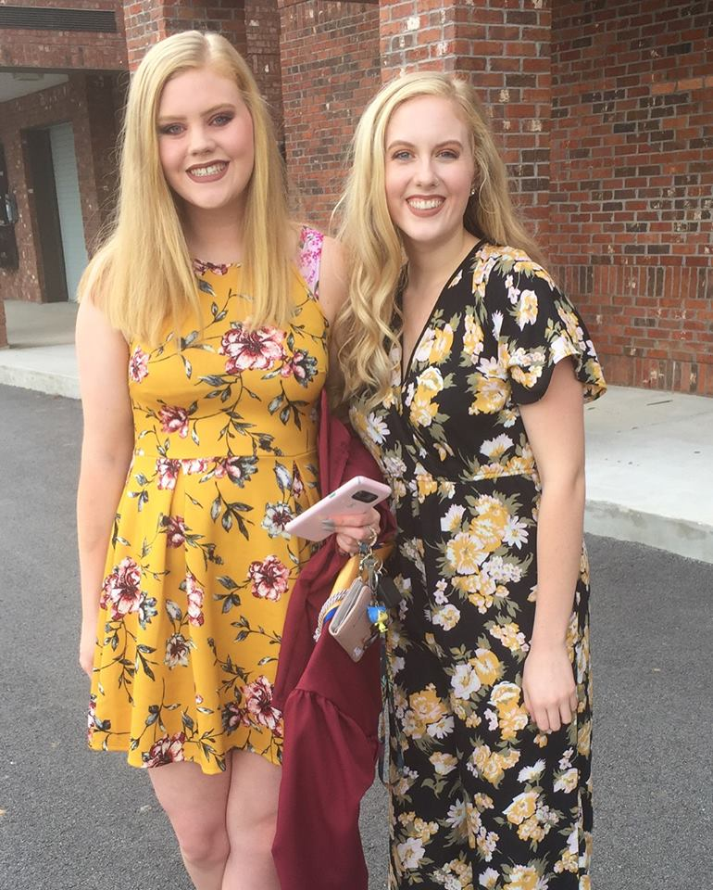
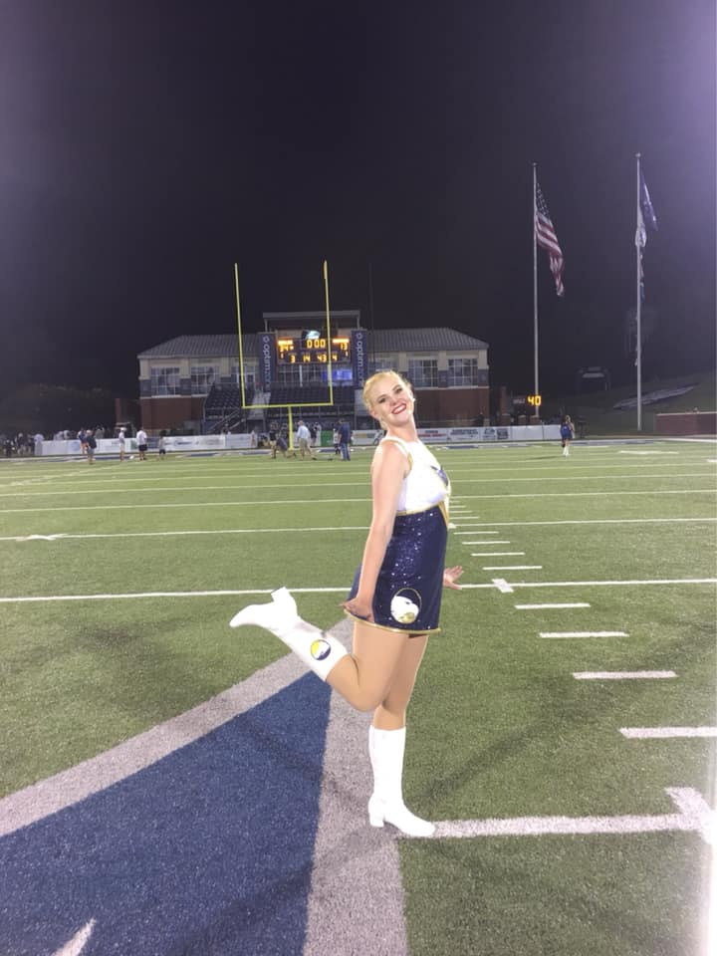
Who Am I? Why Am I Here?

Slide 3
IT Careers
Good news…
IT careers are among the 10 fastest growing US occupations
By 2026 there will be 3.5 million computing related job openings
But…
At the current rate only 17% of those jobs could be filled by computing bachelor’s degree recipients.

Slide 4
What Percentage of US Professional Employees are Women?
57%

Slide 5
What Percentage of US IT Employees are Women?
Women made up 26% of IT employees (2017)
3% African American women
5% Asian women
1% Hispanic women
Down from 35% in 2002
And 41% in 1996

Slide 6
Women in Big IT Companies
Google’s workforce is only 30% female
Only 17% of tech jobs
Yahoo 37%
Facebook 31%
Only 15% are tech jobs
LinkedIn 39%
Twitter 50%
Only 10% are tech jobs

Slide 7
What Percentage of US IT Managers are Women?
US Bureau of Labor and Statistics say 30% of IT managers are women
Educause says 23% of Higher Education CIOs or senior managers are women
7% CIOs were women in 2014, this declined 2% from 2 years earlier
In 2016, 43% of the 150 highest earning public companies had NO female officer at all

Slide 8
Not Just an IT Problem
Women occupy less than 20% senior leadership positions across the public and private sectors
In politics, women constitute over ½ the voting public, but only
19 % of Congress
12 % of governors
19 % of mayors of the nation’s one hundred largest cities.
From a global perspective, the US ranks 97th in the world for women’s representation in political office, below Slovakia, Bangladesh, and Saudi Arabia

Slide 9
Not Just an IT Problem
In academia, women account for a majority of college graduates and post-graduate students but only about ¼ of full professors and university presidents
In law, women are almost ½ of law school graduates but only 18 % of the equity partners of major firms, and 21 % of Fortune 500 general counsels
In the nonprofit sector, women constitute ¾ of staff positions but only 1/5 the leaders of large organizations

Slide 10
Not Just an IT Problem
In business, women account for 1/3 of MBA graduates, but only 4 % of Fortune 500 CEOs
At current rates of change, it could take more than a century for women to reach parity in the C suite

Slide 11
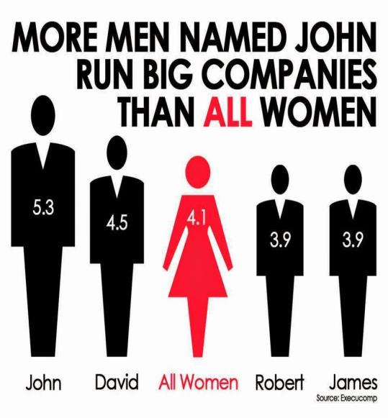
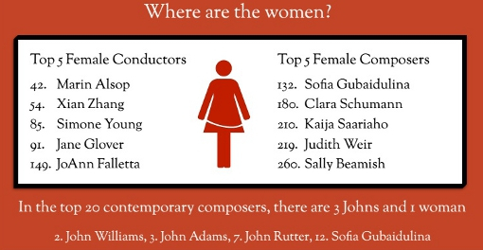

Slide 12
The IT Difference
The numbers of women are gradually increasing in every profession and leadership level EXCEPT IT

Slide 13
My Research
What’s going on?
Does it matter?
How do we fix it?

Slide 14
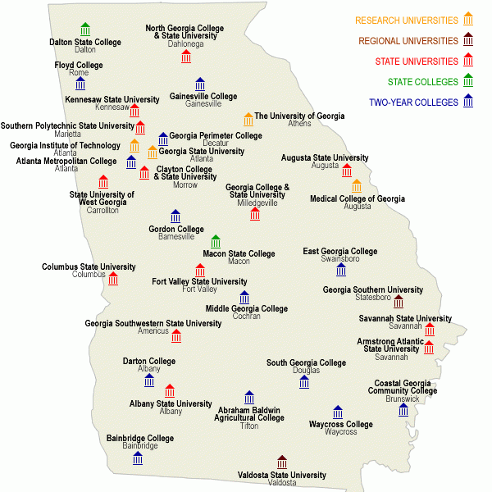
University System of Georgia
28 public institutions all over the state
Governed by a Board of Regents
325k students
158k employees

Slide 15
USG Women 2014
20/30 institutions responded
Overall 30% women
2/30 (7%) institutions have female CIOs or similar role

Slide 16
USG Women 2017
17/28 institutions responded
Overall 22% women (down 8% from 2014)
3/28 (11%) institutions have female CIOs or similar role

Slide 17
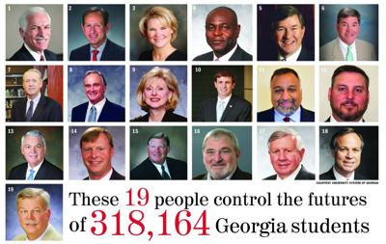

Slide 18
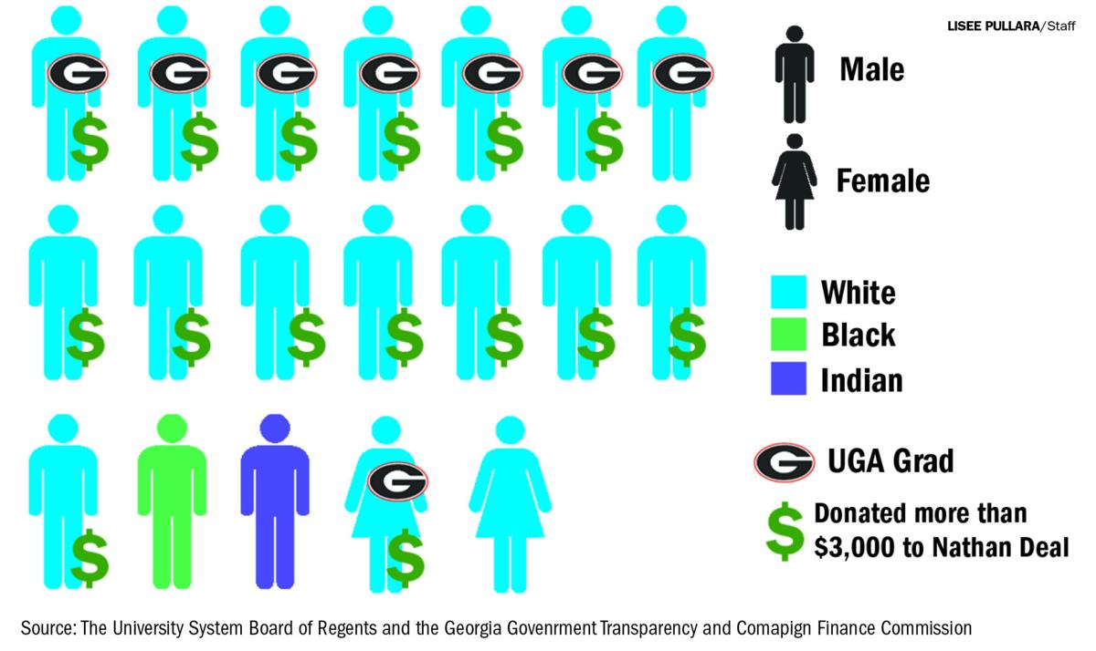

Slide 19
Why?!?!
Input
Throughput

Slide 20
Input
57% of all bachelors degrees are earned by women
19% of CS degrees (It was 37% in 1985)
56% of AP test takers are female
47% of AP Calculus test takers were female
23% of AP CS test takers were female

Slide 21
Input Considerations
69% of girls surveyed say they’d never consider a job in IT because they don’t even know what opportunities are available
Boy parents more aggressively introduce technology than girl parents
No women role models
There’s a perception that IT is a “lifestyle” not just a job
There’s evidence that by first grade children associate math with boys
Personal computers were originally marketed as a toy for boys

Slide 22
Throughput
Women are 2-3x more likely to leave IT

Slide 23
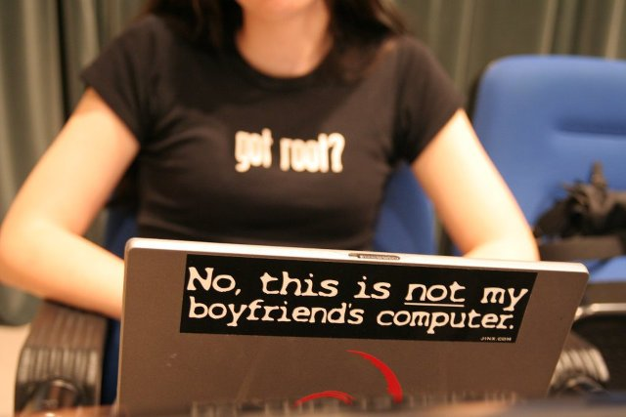
Throughput Considerations
Organizational practices
Masculine work environments
Hiring and promotion practices
Lack of role models and mentors
Stereotypes
Inflexible work policies
Family issues
Personal barriers
Confidence and personal self worth (believe that you can succeed)
Lack of social capitol (relationships)
Networking opportunities
Sense of belonging

Slide 24
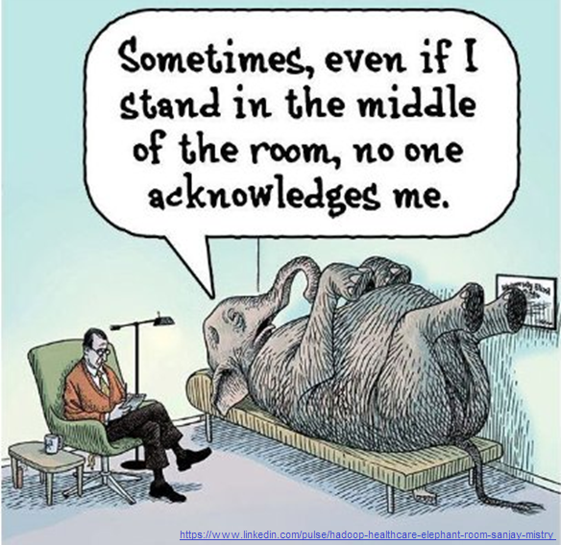
Elephant in the Valley Research
200 Women with at least 10 years experience
Focused on five areas: Feedback & Promotion, Inclusion, Unconscious Biases, Motherhood, and Harassment & Safety
84% told they are too aggressive
66% felt excluded from key social/networking opportunities
88% experienced male peers being questioned when it should have been them
https://www.elephantinthevalley.com

Slide 25
Throughput Considerations
Great progress in overt bias – no more Mad Men
Still challenges with unconscious, implicit, or second generation bias
Invisible barriers
Unconscious Bias
40 bits our 11 million bits
99.99999% unconscious thoughts
Historical/Cultural beliefs about gender
Stereotypes (note taking, hospitality)
Positive vs negative perceptions of the same behavior
Project Implicit, Harvard
Google’s Unconscious Bias Training
Still challenges with institutional bias
Workplace structure
Lack of role models
Tokenism

Slide 26
What’s going on?
Does it matter?
How can we fix it?

Slide 27
Does It Matter?
Gallop Poll found that diverse teams perform better
Men and women have different viewpoints, ideas, and market insights, which enables better problem solving
A gender-diverse workforce provides more knowledge
A gender-diverse workforce allows the company to serve an increasingly diverse customer base
Gender diversity helps companies attract and retain talented women. Companies cannot afford to ignore 50% of the potential workforce and expect to be competitive in the global economy

Slide 28
How Does It Matter?
Improved Performance
Diverse teams make decisions 60% faster
Higher Returns
US companies with diverse boards have a 95% higher ROE than those with homogenous boards
Improved Morale and Engagement
Larger Talent Pool
Legal Protection

Slide 29
What’s going on?
Does it matter?
How can we fix it?

Slide 30
How Do We Fix It?
Talk about it
Learn more
Men have to be involved
Top down discussions, promotion, commitment
Acknowledge that it is a critical business concern
Specifically develop women (it is different)
Institutional and Unconscious Bias Training

Slide 31
Where Do We Start?
Address these organizational issues (everyone’s responsibility):
Cultural fit
Expectation gaps
Lack of role models and mentors
Career satisfaction
Organizational commitment
Role ambiguity
Role conflict

Slide 32
Where Do We Start?
Work on these personal barriers (women’s responsibility):
Personal self worth and believe that you can succeed
Social capitol (relationships)
Networking opportunities
Sense of belonging

Slide 33
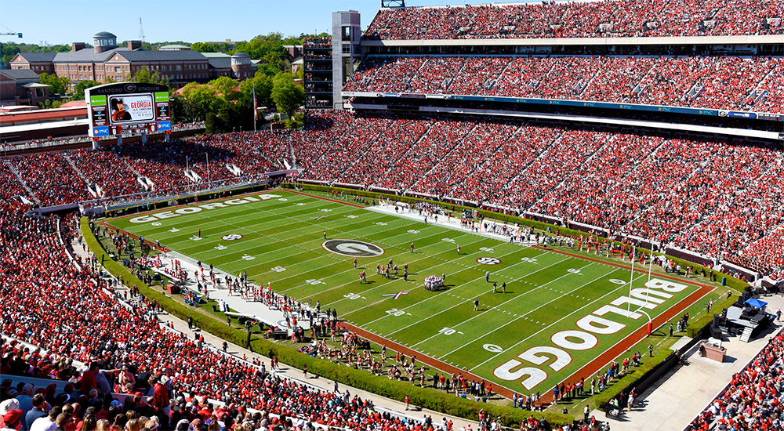
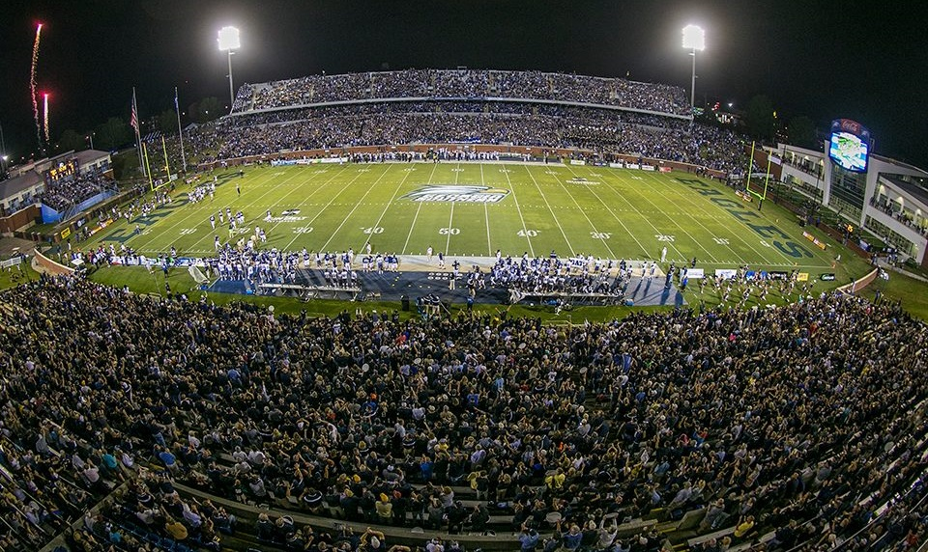
The Rooney Rule

Slide 34
The Rooney Rule
The Rooney Rule is a National Football League policy that requires league teams to interview minority candidates for head coaching and senior football operation jobs
It was established in 2003, and variations of the rule are now in place in other industries
At the start of the 2006 season, the overall percentage of African American coaches had jumped to 22%, up from 6% prior to the Rooney Rule
The problem wasn’t that there weren’t any talented black coaches, the problem was access

Slide 35
The Symphony
Blind orchestra auditions, with musicians behind a curtain, increased the number of female musicians hired by 25%, increasing their total to 46%

Slide 36
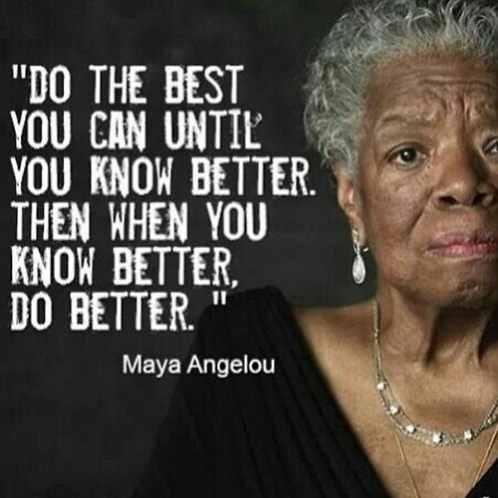

Slide 37
Resources
National Center for Women in Technology - www.ncwit.org
Elephant in the Valley Research - www.elephantinthevalley.com
Gender Bias in performance reviews
https://life.saywerk.com/posts/with-these-gender-biases-at-work-even-performance-reviews-need-performance
https://hbr.org/2017/04/how-gender-bias-corrupts-performance-reviews-and-what-to-do-about-it
Gender neutral recruiting and hiring
https://scienceforwork.com/blog/reducing-gender-bias-hiring/
Project Implicit https://implicit.harvard.edu/implicit/takeatest.html
Diverse companies have higher returns https://www.mckinsey.com/business-functions/organization/our-insights/is-there-a-payoff-from-top-team-diversity
US Bureau and Labor Statistics
Google’s Unconscious Bias Training https://www.businessinsider.com/google-unconscious-bias-training-presentation-2015-12?r=UK&IR=T#the-same-ability-now-gets-us-through-the-day-without-having-to-slowly-process-every-decision-we-make-4
vickir@uga.edu
vicki.rogers@oit.gatech.edu

